Slide 1
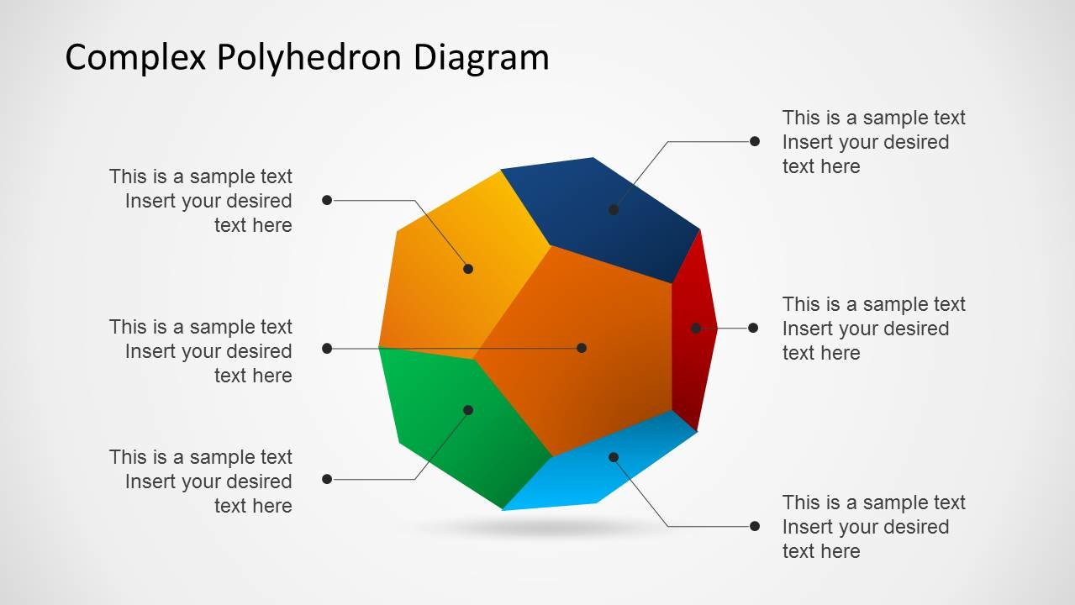
Data Science Skills
Excel book chapters
12, 20, 21, 26, 42, 94, 95
Visualization
Database
Management
24, 30, 43, 46
28, 34, 39, 40
Extraction/
Transformation/
Loading
Inferential Statistics
47-55
2-7, 13, 27, 29, 31-33, 36, 41, 65, 93
Data Mining and
Descriptive Statistics
Modeling
(Predictive & Prescriptive)
1, 11, 14-17, 19, 22, 23, 25, 37, 38, 96
8-10, 18, 35, 56-64, 66-92

Slide 2
Data Science Skills
Other Concepts
Visualization
Database
Management
JMP, Power BI
RDMS, SQL, API, MuleSoft, Access,
Entity Relationship Diagram,
Schema, Cloud, SNOWFLAKE
Extraction/
Transformation/
Loading
Inferential Statistics
Hadoop
Data Mining and
Descriptive Statistics
Modeling
(Predictive & Prescriptive)
Crystal Reports, Cognos, JMP
Spreadsheet Model
JMP Profiler
Relational Database Model

